Slide 1
G2M case study -Cab Industry-
Name : Fawzi El Khatib
Location: Lebanon
Team: Data and Analytics
Date: 15-March-2021

Slide 2
Project Overview and Objectives
Overview: XYZ is a private company in the US. Due to remarkable growth in the Cab Industry in last few years, it is planning for an investment in Cab industry and as per their Go-to-Market strategy they want to understand the market before taking final decision.
Objective: Provide actionable insights to help XYZ firm in identifying the right company to invest in.
In this Presentation we will go through:
Data Understanding
Number of Rides and Profit analysis
Customer Analysis
Recommendation

Slide 3
Data Understanding
Profit calculated using Price Charged – Cost of Trip
Treat our data as a well sample of all trips (80,706 Undescribed Rides, 3023 customers)
Users in City data treated as number of all cab users in the City
Timeframe of the data: 02/01/2016 ➔ 31/12/2018
Assuming no outliers because we don’t have the trip duration
Cab_Data
Customer_ID
City
Transaction_ID
Trips descriptions
359392 Rides
46148 Customers
Customer descriptions
Transactions descriptions
440098
Rides
49171 Customers
Master_Data
46148 Customers
359392 Rides

Slide 4
Number of Rides:
Total: 359392
274681
76.4% of trips
84711
23.6% of trips
General Idea
 | Average |  |  | Median |  |  | Min |  |  | Max
Company
 | Cost of Trip | Price Charged | Profit | Cost of Trip | Price Charged | Profit | Cost of Trip | Price Charged | Profit | Cost of Trip | Price Charged | Profit
Pink Cab | 248.14 | 310.80 | 62.6521 | 246.330 | 298.06 | 41.5 | 19.0 | 15.60 | -220.06 | 576.0 | 1623.48 | 1119.48
Yellow Cab | 297.92 | 458.18 | 160.259 | 295.596 | 425.06 | 102.0 | 22.8 | 20.73 | -176.93 | 691.2 | 2048.03 | 1463.96
Total Profit:
44 020 370
5 307 328

Slide 5
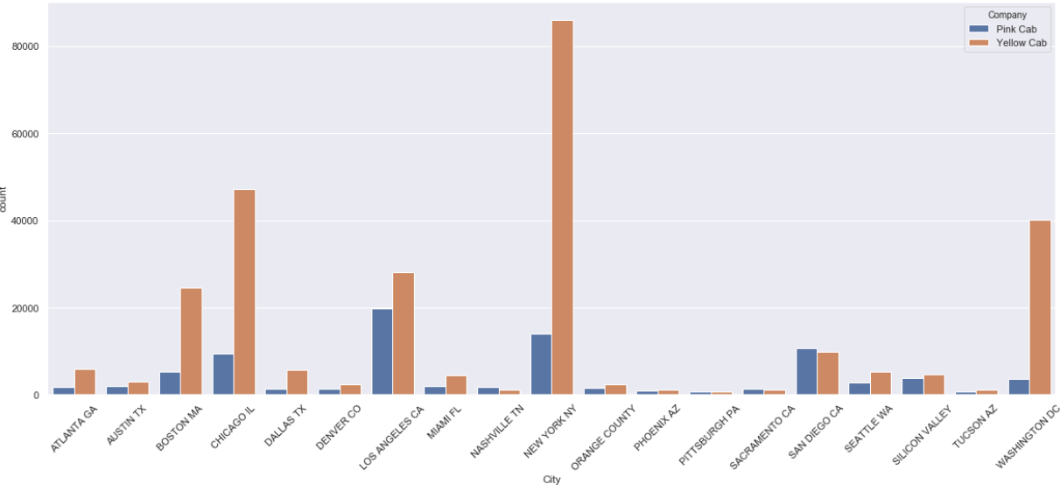
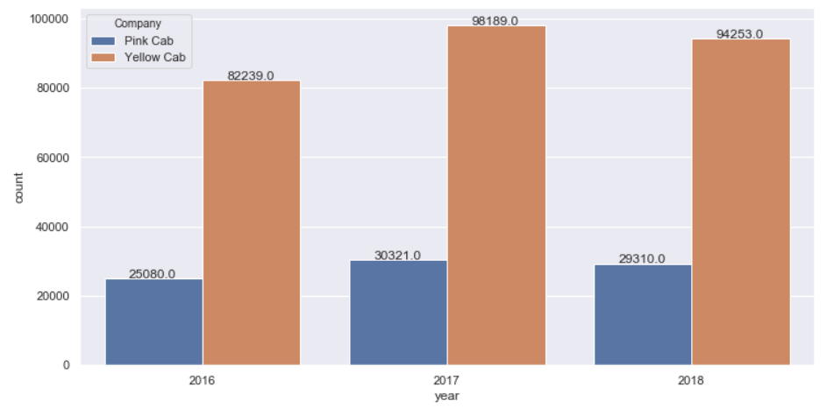
Number of Rides by cities
Pink Cab is dominant in just 4 out of 19 cities
San Diego
Nashville
Sacramento
Pittsburgh
Number of rides over years
Both follow same variation over years
2016 → 2017:
+21%
+19.3%
2017 → 2018:
-3.2%
-4%

Slide 6
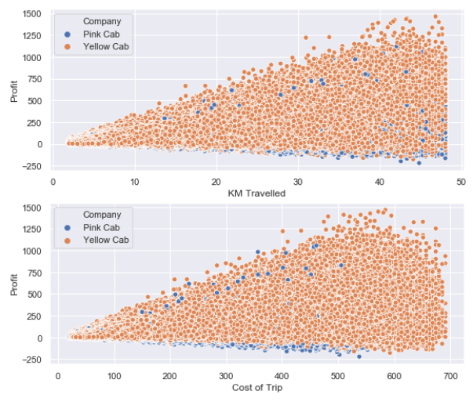
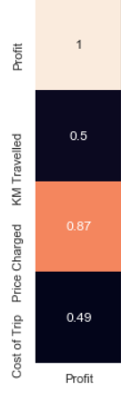
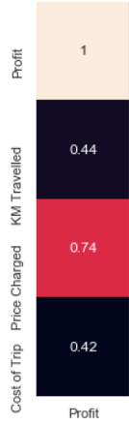
Relationship between “Profit” & “Price, Cost & KM-Travelled”
Yellow Cab
Pink Cab
Unprofitable trips

Slide 7
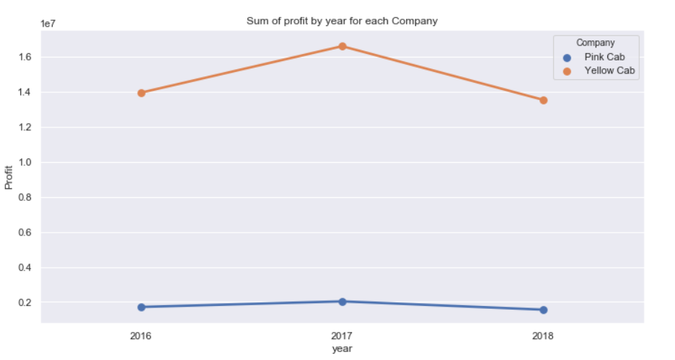
Profit Analysis
Yearly Profit
16.57M
+19%
-18.45%
13.93M
13.52M
2.033M
1.713M
+18.6%
-23.28%
1.56M

Slide 8
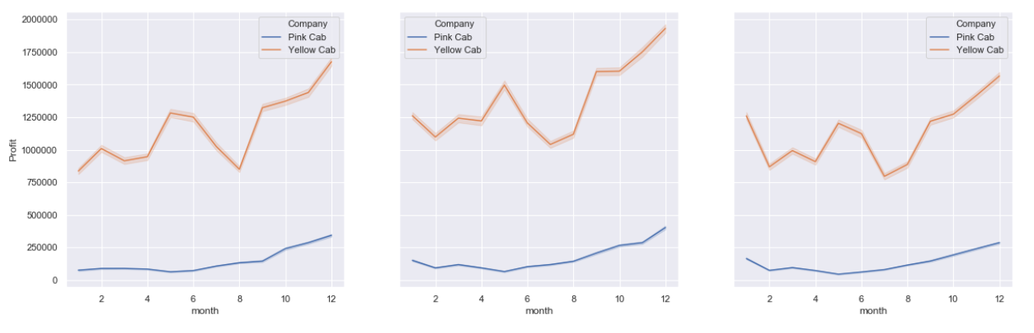
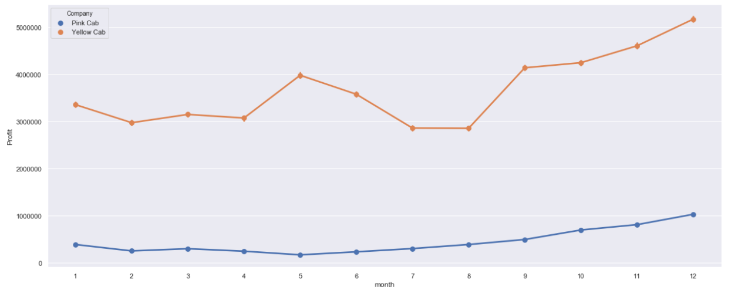
Monthly Profit Analysis
Each of Both firms Follows almost the same variability over the years
2016
2017
2018
+
+
Sum of Profit for each month
=

Slide 9
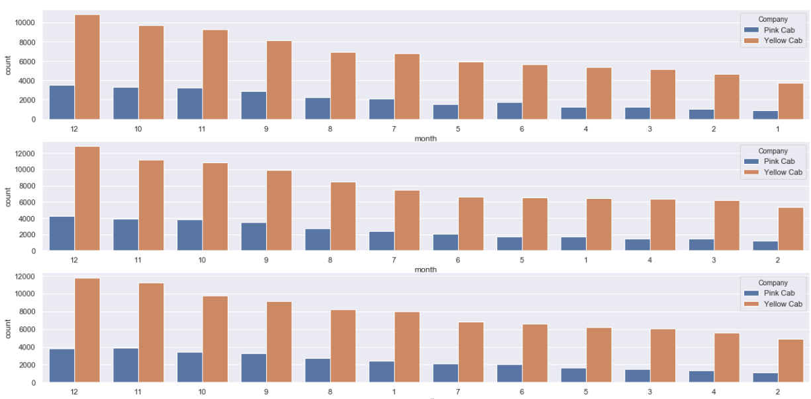
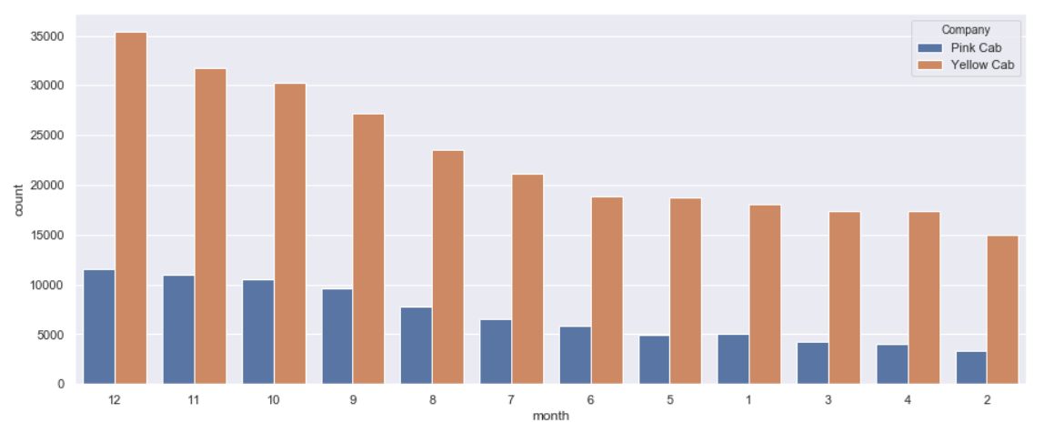
Ride Analysis by months
2016
Both company follow the same distribution over the months
Higher demand from summer till holiday months
2017
2018

Slide 10
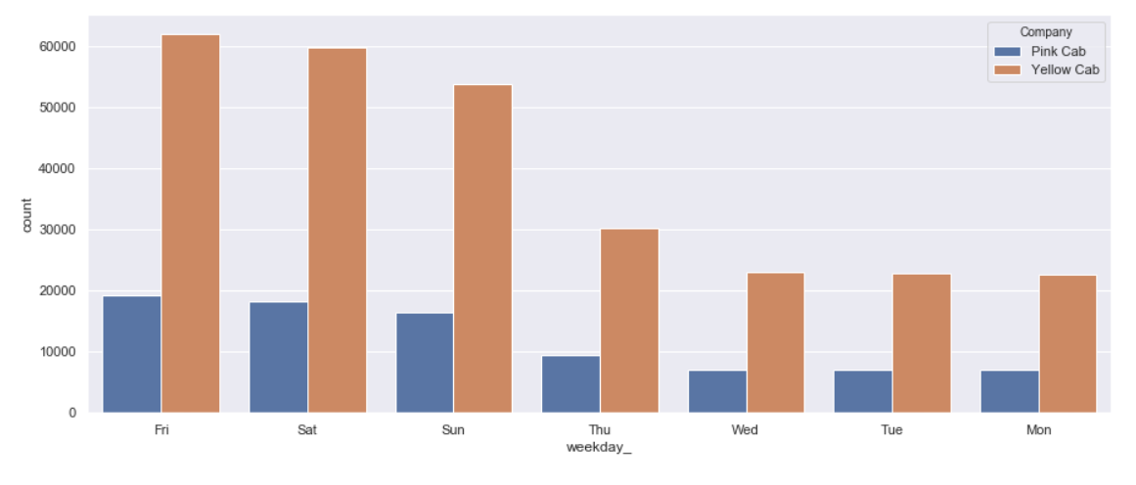
Number of rides analysis by weekdays
Demand on cabs increased in day offs (holidays and weekends)

Slide 11
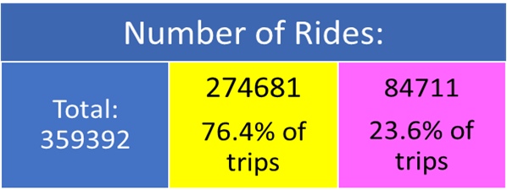
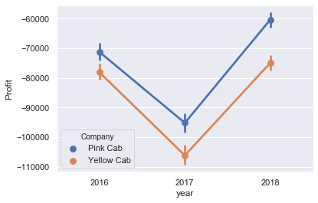
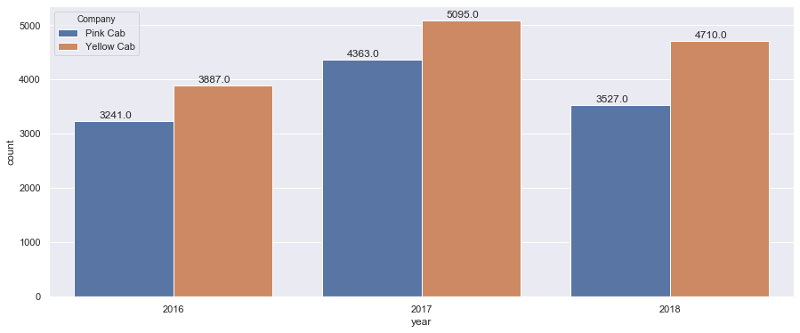
Unprofitable Trips
Remember:
Sum of loss by year
Number of unprofitable rides
13692
≈5% of total rides
11131
≈13% of total rides
Total Profit:
44 M
5.3 M
The differences of losses considered close by comparing them to the differences in profit ➔ Yellow Cab is better in managing more profitable rides.
1142 trips
Also the number of rides that lost more than 50$ is dominant by Pink Cab
Rides of loss <= 50$
1133 trips

Slide 12
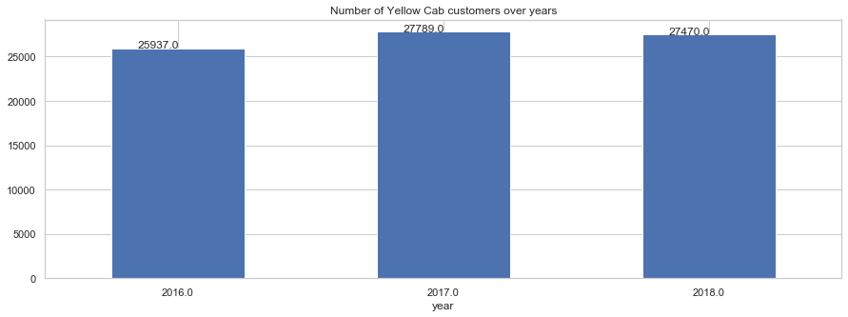
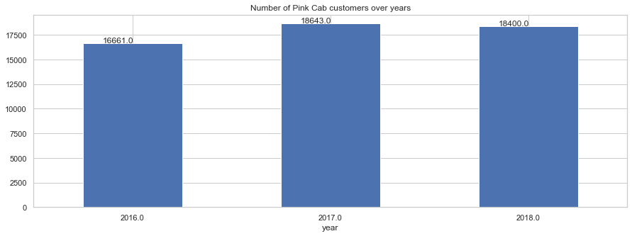
Customer Analysis
Number of customers decreased by 1.1% from 2017 → 2018
2016
2017
2018
Number of customers decreased by 1.3% from 2017 → 2018
2016
2017
2018
By considering the higher customer base of Yellow Cab company comparing to Pink Cab and the in percentage we can say that Yellow is better than Pink cab company in term of Customer retention

Slide 13
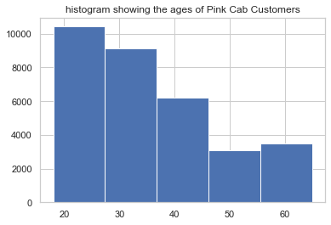

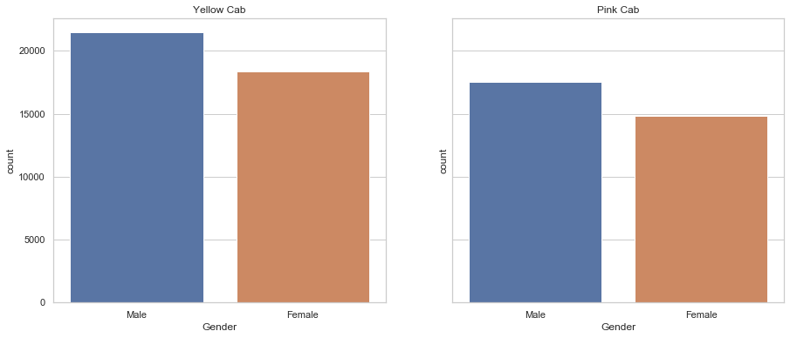
Customer analysis: Age and Gender wise
Both have 25% of their customers btw 42 and 65 years old
The customers are similarly distributed in terms of Age and Gender for both companies
40% of all rides have been made by Women

Slide 14
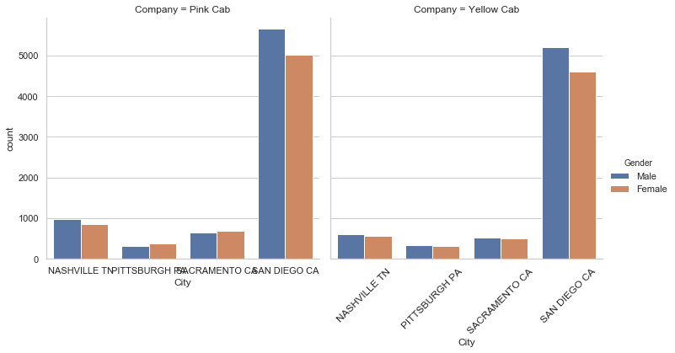

Gender wise analysis for cities where Pink Cab is dominant
number of trips belongs to men is almost always more than women except for Pink Cab in Pittsburgh and Sacramento
The Pink color has no significant influence in attracting women customers

Slide 15
Conclusion:
Based on the evaluation of both the cab companies. We found that the Yellow Cab is better than Pink Cab in terms of:
Customer reach: Yellow Cab is dominant by all the cities except 4.
Profit: Overall, Average profit. Yearly profit, Monthly profit showed stability for Yellow Cab
Unprofitable trips: Yellow Cab is better in managing the rides.
Customer Analysis: Yellow Cab has a much bigger Customer base than Pink Cab.
Recommendation:
We Recommend Yellow Cab for investment

Slide 16
Thank You

